Slide 1
Computer Architecture
Reference:
- Mano, “Computer System Architecture”, Chapter 8
Central Processing Unit Architecture
  Design Approaches [Stack – Pipelining – Interrupt – Processor Organization –
Registers Organization]
  Instruction Set Architecture [Instruction Format – Addressing modes – Data
Transfer and Manipulation]
  Example architectures (e.g. CISC, RISC)
Timing, Clock Parameters, and Processor Performance
Memory Hierarchy
  Main Memory
  Cache Memory
  Virtual Memory 2
Computer Architecture Module Content

Slide 2
Processor Organization
3
Processor Organization
Single register (Accumulator) organization
» Basic Computer is a good example
» Accumulator is the only general purpose register
General register organization
» Used by most modern computer processors
» Any of the registers can be used as the source or destination for computer operations
Stack organization
» All operations are done using the hardware stack
4

Slide 3
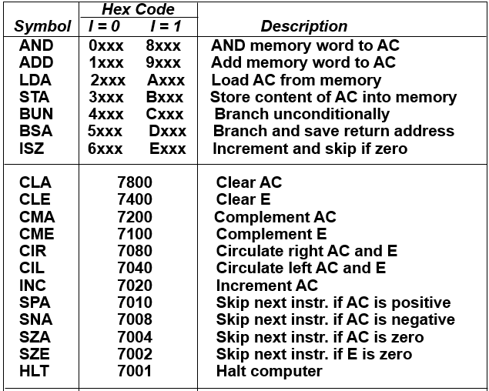
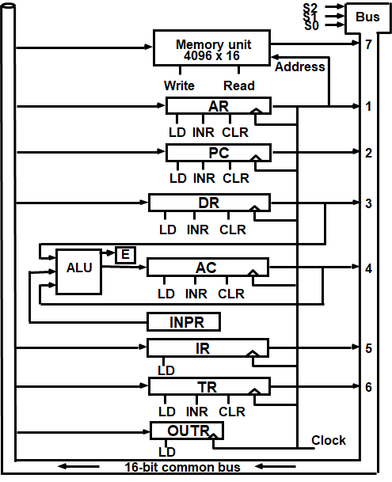
Processor Organization
Single register (Accumulator) organization
General register organization
Stack organization
5
Single register (Accumulator) organization
4

Slide 4
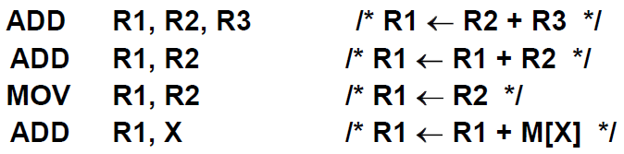
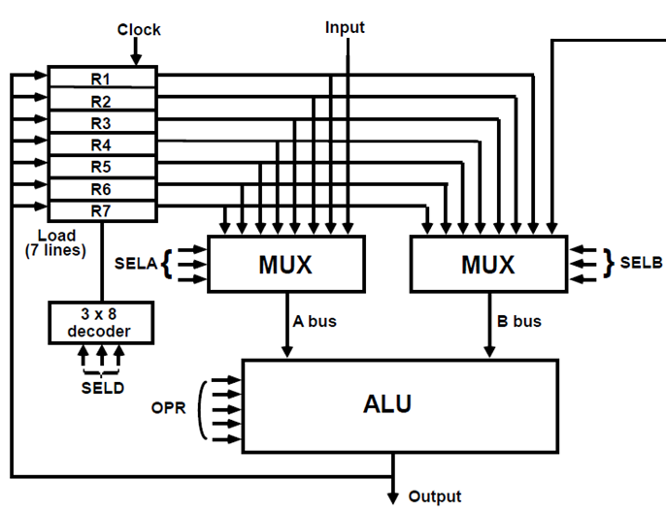
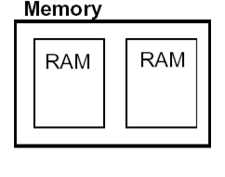
Processor Organization
Single register (Accumulator) organization
General register organization
Stack organization
8
General Register Organization
RTL (register-transfer level) Example:
9

Slide 5
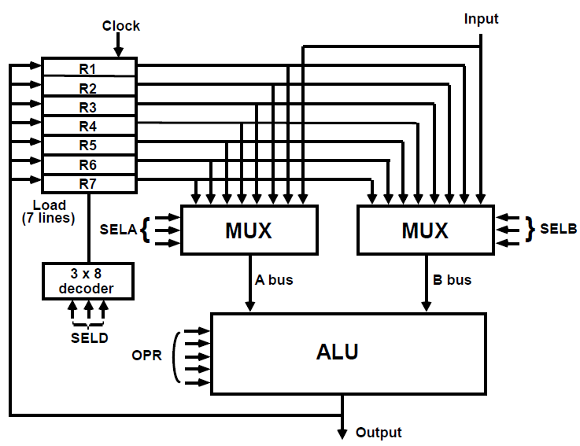
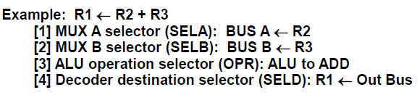


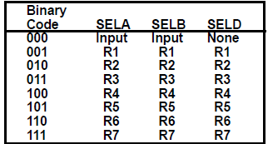
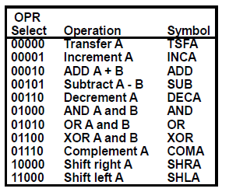
Example
10
Example
9

Slide 6

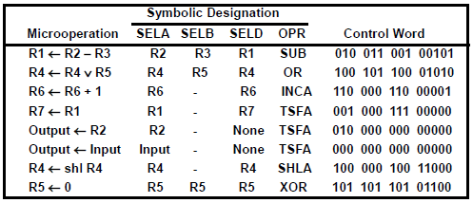

Examples of Microoperations
12
Processor Organization
Single register (Accumulator) organization
General register organization
Stack organization
13

Slide 7
Instruction Format
14
Instruction Fields
OP-code: specifies the operation to be performed
Address: designates memory address(es) or a processor register(s)
  The number of address fields in the instruction format depends on the internal organization of the CPU.
(e.g. data memory separate from instructions memory)
Address Mode: determines how the address field is to be interpreted (to get
the effective address or the operand)

Slide 8


Processor Organization
Single register (Accumulator) organization
Depend on ALU operands
one Address Instructions
General register organization
Two, or Three Address Instructions
Stack organization
Zero Address Instructions
16

Slide 9

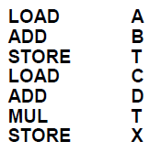
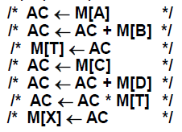
Computer with One address instructions
Accumulator-type computer
  Use an implied AC register for all data manipulation (there is no need to specify it in the
instruction).
  One operand is in the accumulator and the other is in the register or memory location.
  Example:
X = (A+B)*(C+D)
Computer with One address instructions

Slide 10

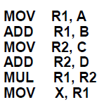
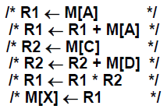



Computer with Two address instructions
Instruction Format
  Destination address also contains operand.
Example:
X = (A+B)*(C+D)
Computer with Three address instructions
Instruction Format
  Short programs - Instruction becomes long
(a large number of bits → which lead to larger memory word for instructions)
Example:
X = (A+B)*(C+D)

Slide 11
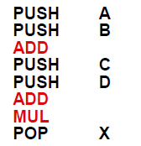
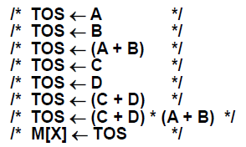
ALU connections for
Computer with Two or Three address instructions
22
Stack-organized Computer
(zero-address instructions)
A stack-based computer does not use the address field in the instruction. It is converted to reverse Polish (Postfix) Notation to evaluate an expression.
Example:
X = (A+B)*(C+D)

Slide 12
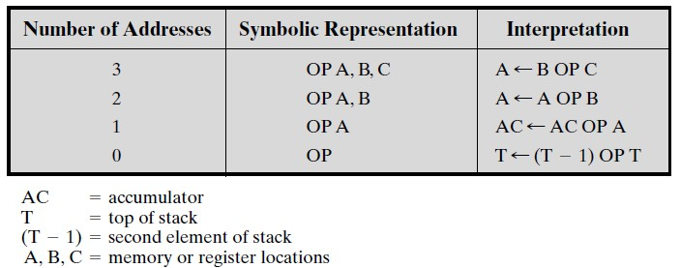
Summary of Instruction Addresses
(Nonbranching Instructions)
Instruction Format
Three-address instruction formats are not common because they require a relatively long instruction format to hold the three-address references.
In Two-address instructions, one address must do double duty as both an operand and a result. Thus, the instruction SUB Y, B carries out the calculation Y – B and stores the result in Y. The two-address format reduces the space requirement but also introduces some confusion.
Zero-address instructions are applicable to a special memory organization, called a stack. A stack is a last-in-first-out set of locations. The stack is in a known location and, often, at least the top two elements are in processor registers. Thus, zero address instructions would reference the top two stack elements.

Slide 13
Instruction Format trade-offs
The number of addresses per instruction.
The address references a memory location or a register.
Processor Organization trade-offs
Accumulator-type computer
  Example:
X = (A+B)*(C+D)
7 Instructions
6 memory access
Each Instruction takes 4-6 micro-operations (clock cycles)

Slide 14
Processor Organization trade-offs
Two address format
Example:
X = (A+B)*(C+D)
6 Instructions
5 memory address
Processor Organization trade-offs
Three address format
Example:
X = (A+B)*(C+D)
3 Instructions
3 memory address (use dual channel memory)

Slide 15
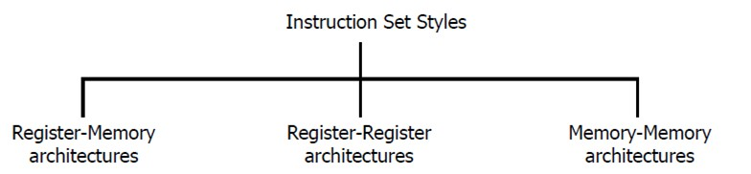
Instruction Format trade-offs
The number of addresses per instruction is a basic design decision:
  Fewer addresses per instruction result in simple instructions, requiring a less complex processor. It also results in instructions that are shorter in length.
  But, programs contain a greater number of instructions, which in general results
in longer execution times and longer, more complex, programs.
  On the other hand, register references are faster than memory references, multiple-address instructions speed up execution.
For reasons of flexibility, most current machines have a mixture of two- and three-address instructions.
Instruction Format trade-offs
2. The address references a memory location or a register.

Slide 16
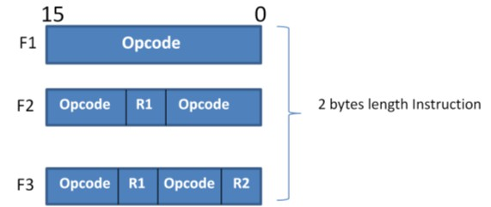
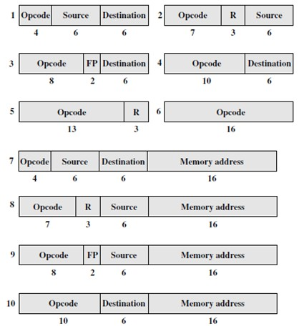

Instruction Format Example
Most processor designs involve a variety of instruction formats.
Basic Computer
Example of Instruction Format Dell M6800 CPU
15 14
12 11
0
I | Opcode | Address
0 1 1 1
12 11
Register operation
0
1 1 1 1
12 11
I/O operation
0
Variable-Length Instructions
Instruction Formats for the PDP-11
16-bit Processor (Example)

Slide 17
Addressing Modes
36
Addressing Modes
Specifies a rule for interpreting or modifying the address field of the instruction (before the operand is actually referenced)
Variety of addressing modes
  Give flexibility to the programmer
  Efficiently use the bits in the address field of the instruction

Slide 18
Types of Addressing Modes
Implied mode (i.e. Stack)
Immediate mode
Register mode
Register Indirect mode
Autoincrement or Autodecrement mode
Direct address mode
Indirect address mode
Displacement/Relative Addressing Modes
  PC Relative Addressing mode
  Indexed Addressing Mode
  Base Register Addressing Mode
What is the effective address?
The address field of an instruction is used by the control unit in the CPU to obtain the operand from memory.
Sometimes the value given in the address field is the address of the operand, but sometimes it is just an address from which the address of the operand is calculated.
To differentiate among the various addressing modes it is necessary to distinguish between the address part of the instruction and the effective address used by the control when executing the instruction.
The effective address is the address of the operand in a computational type instruction.

Slide 19


What is the effective address?
The address of the Data required.
Example:
(a)
Direct addressing
(b)
Indirect addressing
What is the effective address of the following instruction
22
0
ADD
457
35
1 | ADD | 300
1350
Operand
300
457
Operand
1350
(a) 457
(b) 1350
+
+
AC
AC
Implied Mode/Stack Mode
The operands are specified implicitly in the definition of the instruction.
For example, the instruction “complement accumulator” is an implied-mode instruction because the operand in the accumulator register is implied in the definition of the instruction. (examples from Basic Computer: CLA, CME, INP)
Zero-address instructions in a stack-organized computer are implied-mode instructions since the operands are implied to be on top of the stack.
No need to specify an address in the instruction
For stack organization: EA = SP
Some other instructions: EA = AC, or address of INP register

Slide 20

Immediate Mode
The operand is specified in the instruction itself.
The instruction has an operand field rather than an address field.
The operand field contains the actual operand to be used in conjunction with the operation specified in the instruction.
Immediate-mode instructions are useful for initializing registers to a constant value.
Fast to acquire an operand
Direct Mode
The operand exists in memory and its address is given directly by the address field of the instruction.
Faster than the other memory addressing modes
Too many bits are needed to specify the address for a large physical memory space
The effective address is equal to the address part of the instruction. EA = IR(addr)

Slide 21
Indirect Mode
The address field of an instruction specifies the address of a memory location that contains the address of the operand
Slow to acquire an operand because of an additional memory access
EA = M[IR(address)]
Register Mode
The operands are in registers that exist in the CPU.
The particular register is selected from a register field in the instruction.
A k-bit field can specify any of 2^{k} registers.
Shorter address than the memory address
Faster to acquire an operand than the memory addressing
EA = IR(R) (i.e. IR(R): Register field of IR)

Slide 22
Register Indirect Mode
The selected register contains the address of the operand rather than the operand itself.
Before using a register indirect mode instruction, the programmer must ensure that the memory address of the operand is placed in the processor register with a previous instruction.
The advantage of a register indirect mode instruction is that the address field of the instruction uses fewer bits to select a register than to specify a memory address directly.
Slower to acquire an operand than direct memory addressing
EA = M[IR(R)]
Autoincrement or Autodecrement Mode
When the address in the register is used to access memory, the value in the register is incremented or decremented by 1 automatically.
When the address stored in the register refers to a table of data in memory, it is necessary to increment or decrement the register after every access to the table. This can be achieved by using the increment or decrement instruction.
This is similar to the register indirect mode except that the register is incremented (or decremented) after (or before) its value is used to access memory.
However, because it is such a common requirement, some computers incorporate a special mode that automatically increments or decrements the content of the register after data access.
EA = M[IR(R)+1]
EA = M[IR(R)-1]

Slide 23
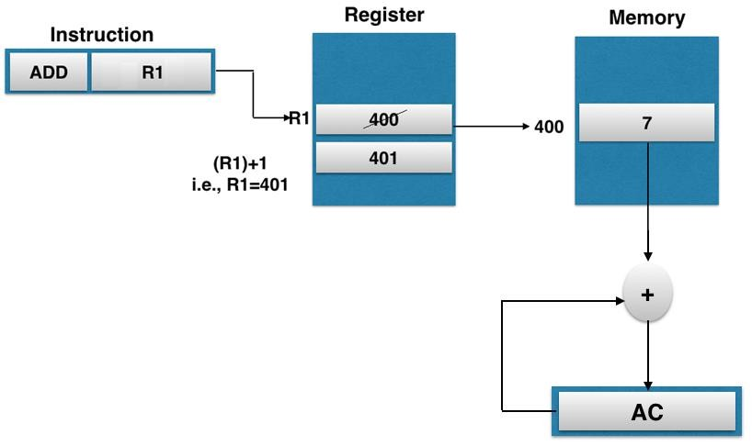
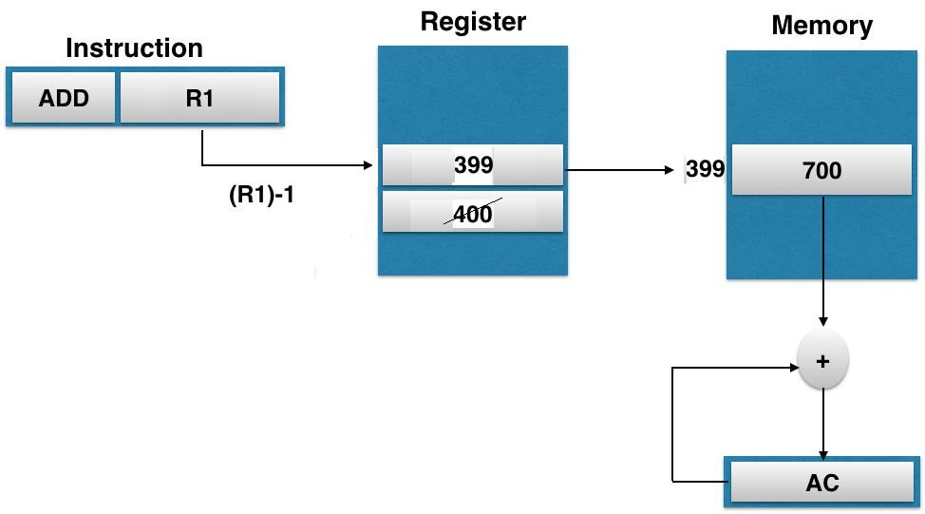
Types of Addressing Modes
Auto-increment Addressing Mode:
Types of Addressing Modes
Auto-decrement Addressing Mode:

Slide 24
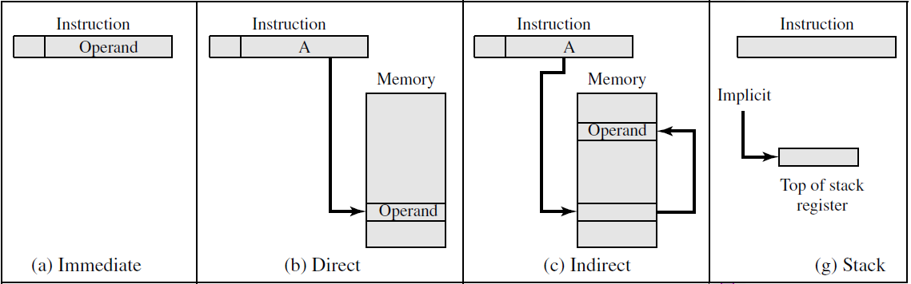
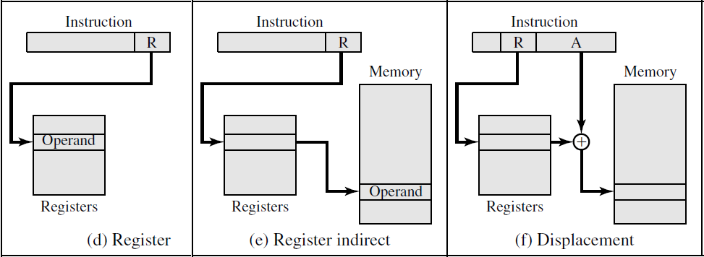
Types of Addressing Modes
Types of Addressing Modes

Slide 25
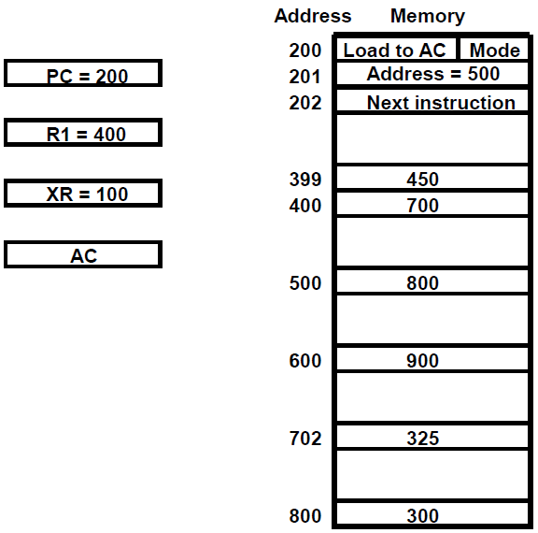
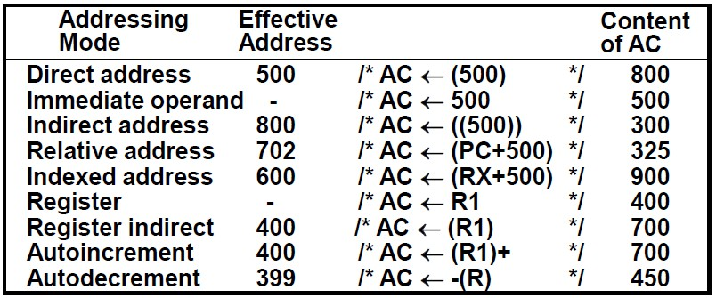
Example 1
Load operation
Example 1
Load operation
R1

